Slide 1
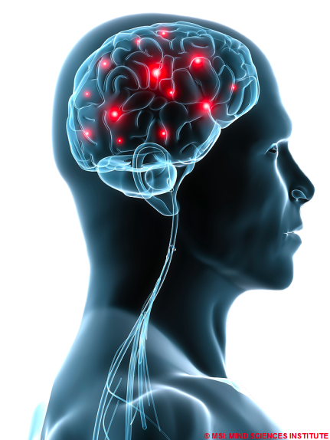
Brain Backups
Russell Hanson
July 31, 2012

Slide 2
Outline
  The Team
  The Mission
  The Market
  The Technology

Slide 3
The Team
Executive direction: CEO, CTO, CFO
Engineering: neuroscience, physics, bioengineering
Legal counsel for IP, patent and discovery work
Nanotech counsel
Neuroscientists and neuroengineers
Mechanical/biological engineers and synthetic biology
Imaging resources (fMRI, X-ray CT)
Imaging collaborators from large companies (GE, Siemens, etc.)

Slide 4
The Mission
The human brain contains about ~100 billion nerve cells, or neurons.
On average, each neuron is connected to other neurons through about 10 000 synapses.
The actual figures vary greatly, depending on the local neuroanatomy.
100 000 000 000 neurons * 10 000 synapses = 1 000 000 000 000 000
1 terabyte = 1 099 511 627 776 bytes
1 000 000 000 000 000/1 099 511 627 776 = 909.49 terabytes
1 terabyte hard drive = ~$90 → storage for all human neurons and synapses ~$90 * 909.49 = ~$81,854
The market is the demographic who can afford the $81,000 (and decreasing)
storage cost plus the cost of the scanning procedure. Flexible
payment/insurance plans available.

Slide 5
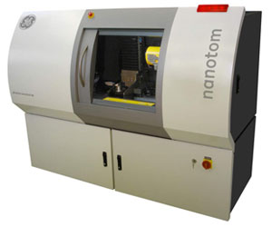
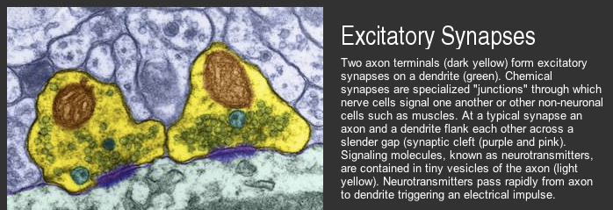
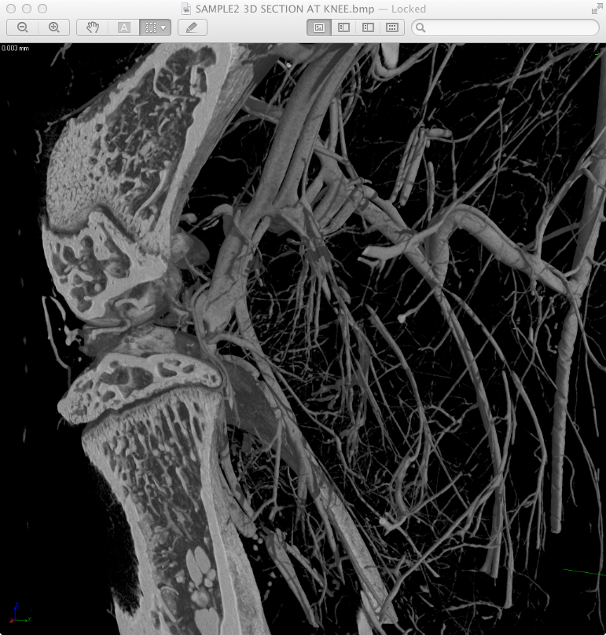
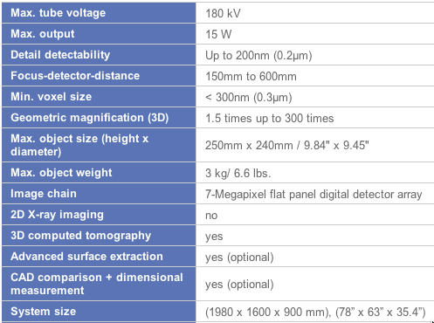
High Resolution Imaging

Slide 6
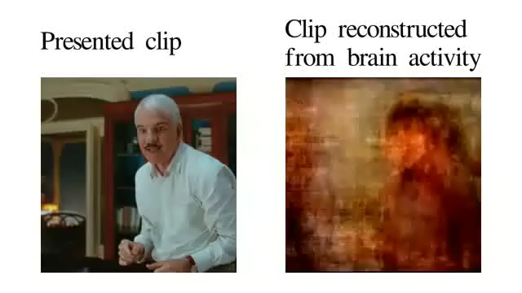
Decoding the visual cortex

Slide 7
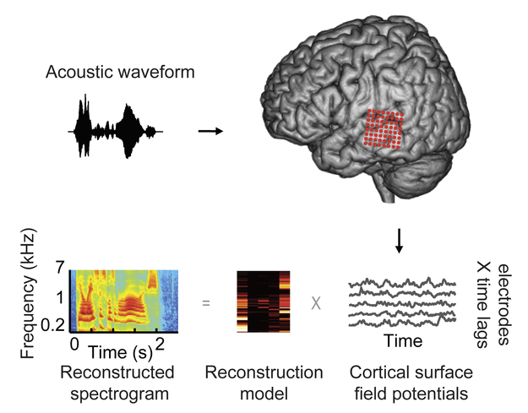

Decoding the auditory cortex

Slide 8
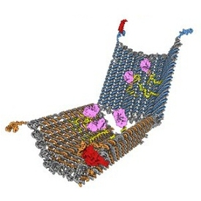

Development of a BrainBot
Flash memory attached to biological sensor/substrate
DNA memory/cellular memories (Burrill DR, Silver PA. Making cellular memories. Cell. 2010 Jan 8;140(1):13-8.)
Sensor, aptamer probes, etc.
Image from: Douglas SM, Bachelet I, Church GM. A logic-gated nanorobot for targeted transport of molecular payloads. Science. 2012 Feb 17;335(6070):831-4.

Slide 9
What we need
Early seed stage funding
Access to later series stage funding
Development of Science Advisory Board (SAB) and Advisors
Marketing and legal development and protection of inventions
Scientific development of the apparatus and additional basic neuroscience

